Slide 1

Library Tracker ER Diagram
Biplob Hasan Nibir
CSE 32n
ID: 231-112-006

Slide 2
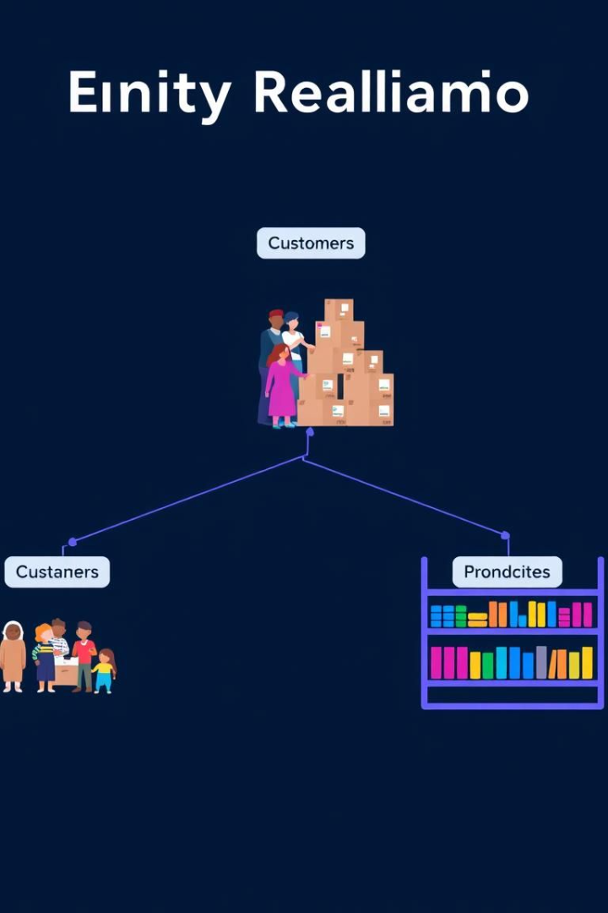
What is an ER Diagram?
Entity-Relationship Diagram (ERD)
Purpose
Maps out entities, attributes, and relationships.
A visual blueprint of a database.
Benefit
Simplifies database design and understanding.

Slide 3
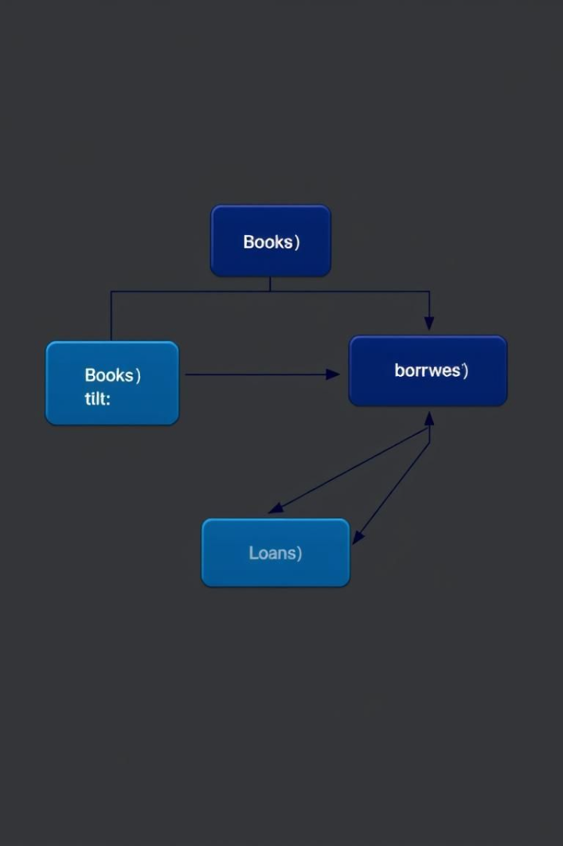



Key Components
Entities
Represented as rectangles. E.g., Books, Borrowers.
Attributes
Listed inside entities. E.g., Book Title, Borrower ID.
Relationships
Shown as lines connecting entities. E.g., borrows.

Slide 4
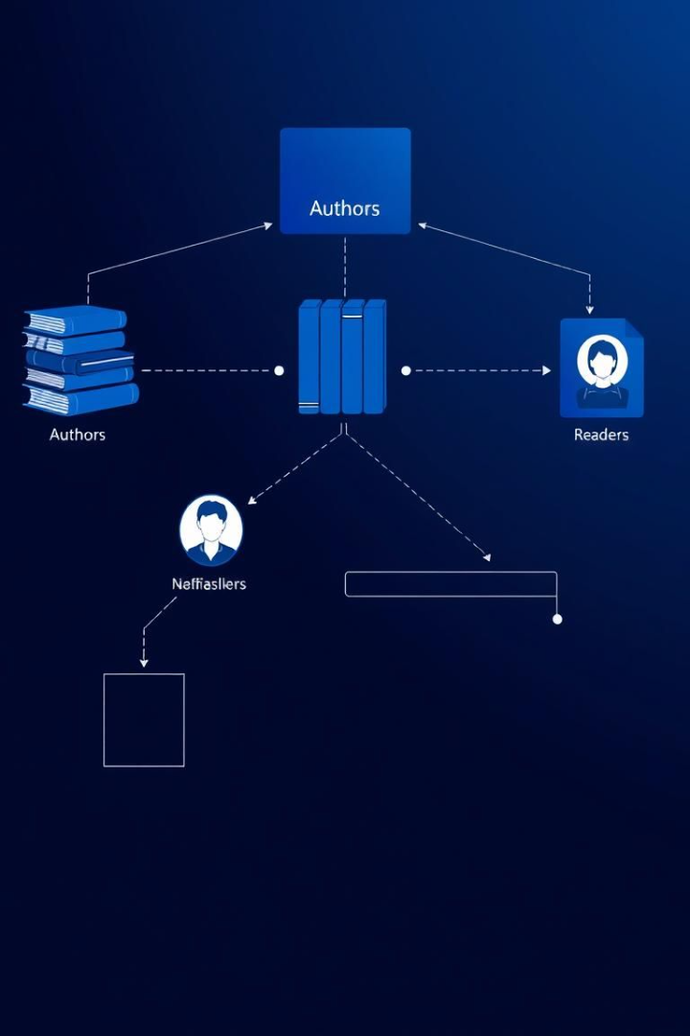
Library Database: Overview
Books
Borrowers
Stores book information.
Contains borrower details.
Borrowed
Tracks lending activity and due dates.

Slide 5
ER Diagram: Books Table
id (PK)
title
Primary key. Unique identifier for each book.
The full title of the book.
author
isbn
The author of the book.
International Standard Book Number.

Slide 6
ER Diagram: Borrowers Table
id (PK)
name
Primary key. Unique identifier for each borrower.
The full name of the borrower.
email
phone
Borrower's email address for communication.
Borrower's phone number.

Slide 7
ER Diagram: Borrowed Table
1
id (PK)
2
book_id (FK)
Primary key. Unique identifier for each borrowing record.
Foreign key referencing the Books table.
3
borrower_id (FK)
4
return_date
Foreign key linking to the Borrowers table.
Records the date the book was returned.

Slide 8
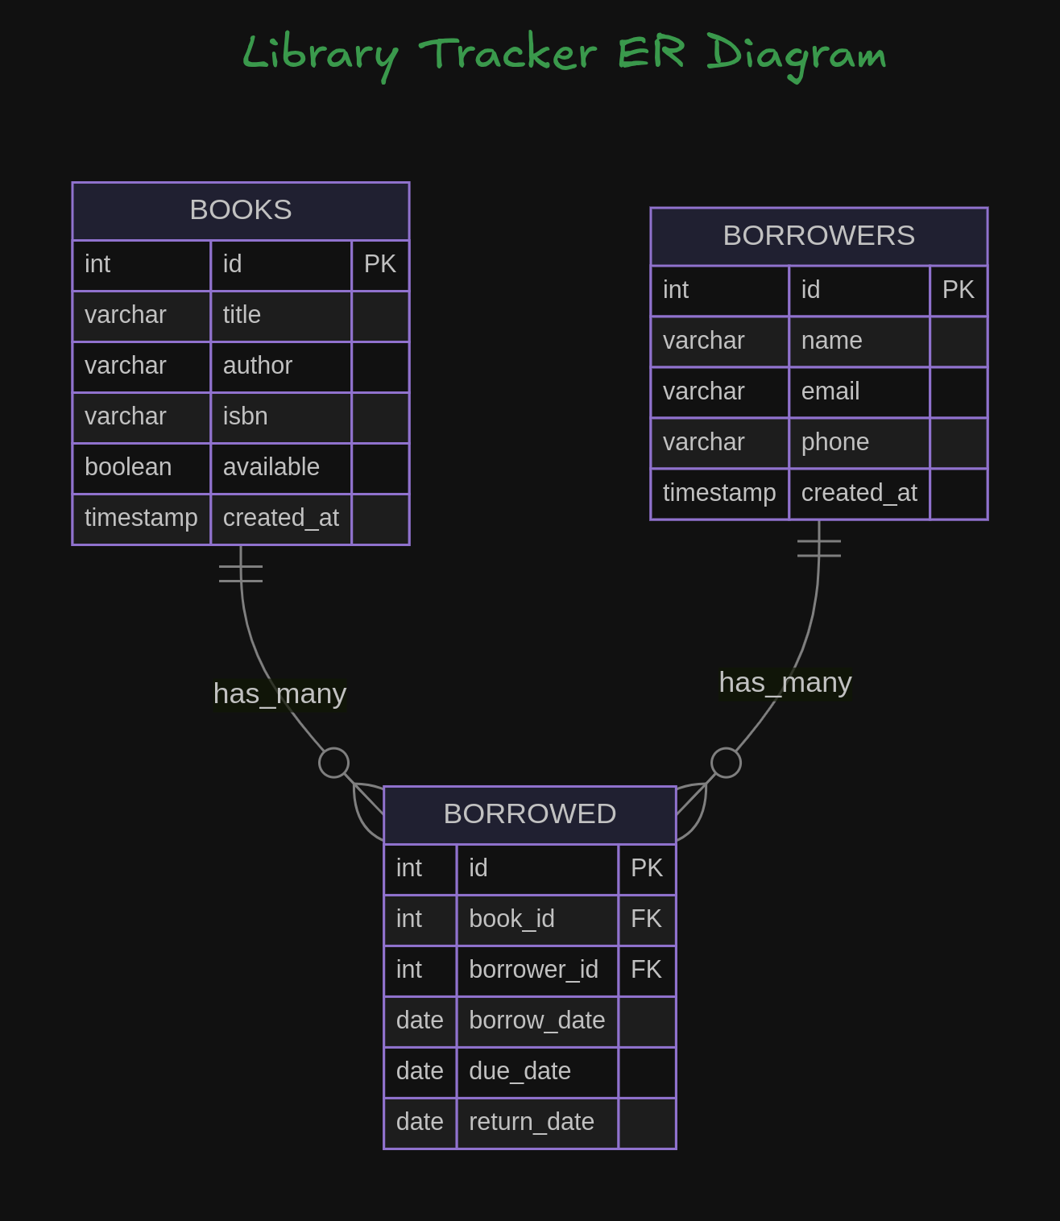
Relationships: Connecting the Tables
1
Books borrowed by Borrowers
2
Books appear on Borrowed
3
Borrowers borrow Borrowed
Illustrate relationships with simple lines and labels.

Slide 9








System Features
Book Tracking
Borrower Management
Manage book inventory.
Maintain borrower records.
Lending Activity
Due Date Monitoring
Monitor who borrowed what and when.
Track lending periods.

Slide 10

Summary
1
2
Simplified Design
Solid Foundation
ER Diagrams simplify database design.
This Library Tracker ERD provides a solid foundation.
3
Enhanced Efficiency
Enhances library efficiency.

Slide 11
Thank You!

